Slide 1
Non-Photorealistic Rendering of Images

Slide 2
Work Division
This project has been dealt with in three phases-
Phase 1
Identifying explicit features
Phase 2
Verification using viewers
Phase 3
Technology(Coding)

Slide 3
Phase 1
In this phase we tried to identify the explicit features in a group of paintings belonging to the same period and/or to the same artist.
Following are the styles we implemented using image processing tools
Fauvism
Pointillism
Cubism
Divisionism
Post Impressionism(Van Gogh)

Slide 4
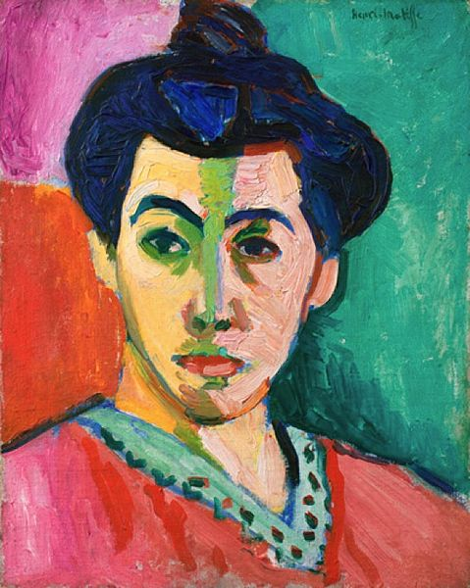
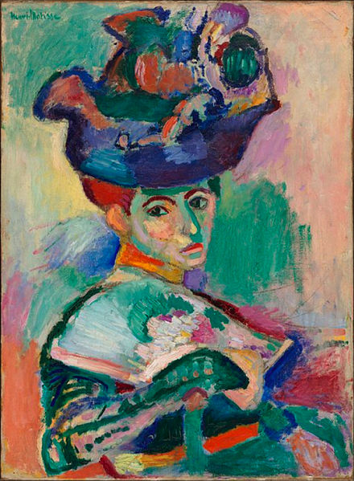
Phase 1
Fauvism
The subject matter is simple. The paintings are made up of non-realistic and strident colours and are characterized by wild brush work.

Slide 5
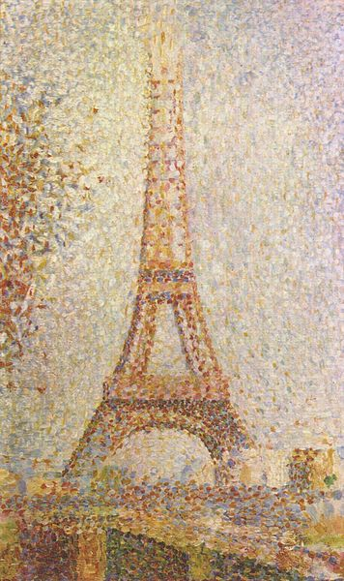
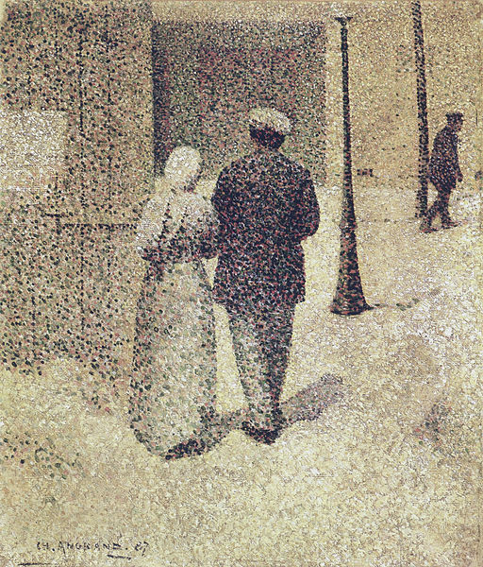
Phase 1
Pointillism
We noticed that the paintings had a lot of noise in them and it looked like they were made by grouping many dots together in a proper way. There’s no focus on the separation of colours.

Slide 6
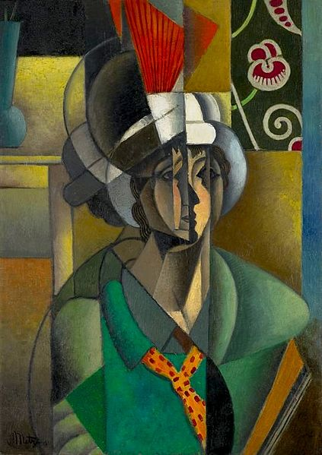
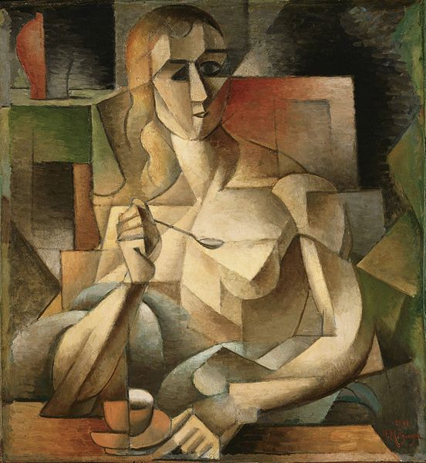
Phase 1
Cubism
It looked as if the painting was looked through a shattered glass which makes it look distorted.

Slide 7
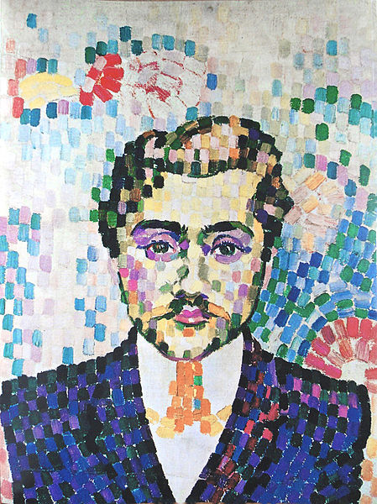
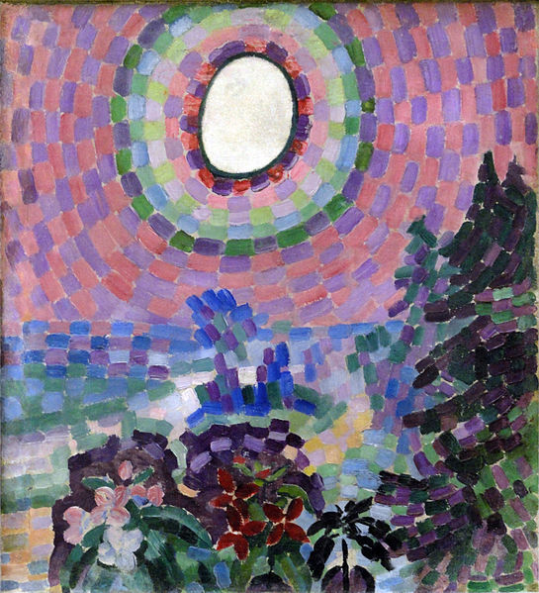
Phase 1
Divisionism
The paintings are made up of small rectangles with curved edges each with a single colour which interact visually.

Slide 8
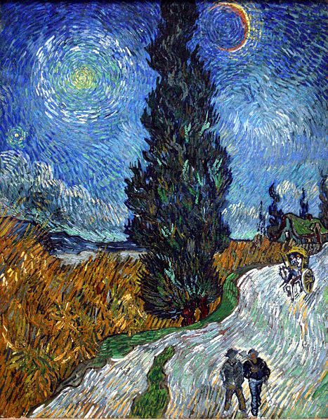
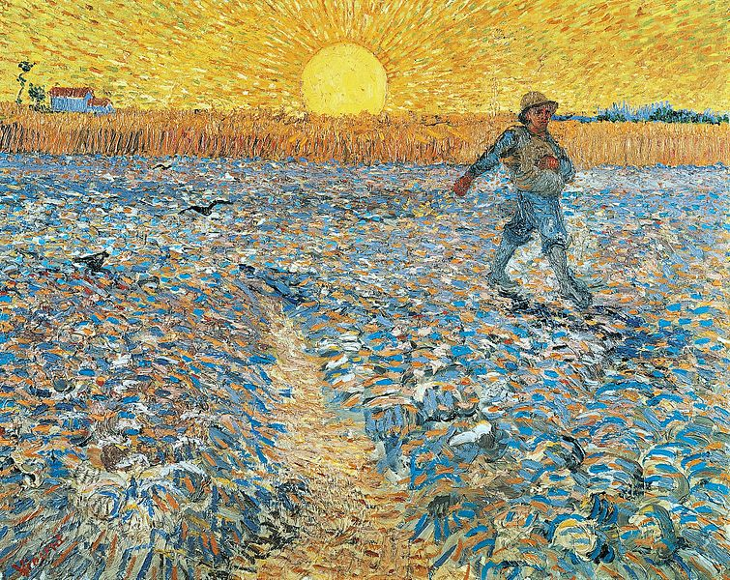
Phase 1
Post Impressionism (Van Gogh)
These paintings have small, thin yet visible brush strokes. They have a bright, bold palette. Unnatural and arbitrary colours are used.

Slide 9
Phase 2
In this phase we verified the features we identified in phase 1 with other people
We showed them a group of paintings belonging to a certain era and/or an artist and asked them to write down the most striking features common to all those paintings.

Slide 10
Phase 2
Here are the inferences we made from the statistics collected
Fauvism (Henri Matisse)
Non-realistic colours are used but the paintings are seemingly realistic.
Gradients are not smooth
Pointillism (Georges Seurat)
Discrete brush strokes
Point/Blotch like pattern
The subject is made to stand out by use of more darker strokes
A lot of noise is seen.

Slide 11
Phase 2
Cubism (Pablo Picasso)
Real images are made by geometrical shapes
Many sharp edges, many perspectives in one image
Highly abstract, smooth colours
Divisionism (Robert Delaunay)
Distinct rectangular boxes are used to make the painting
Use of random colours
Post Impressionism (Van Gogh)
The strokes in the paintings give a sense of motion in the picture.
Use of different gradients

Slide 12
Comparison of Phase 1 and Phase 2
We notice that the features that we found in phase 1 are very similar to the inferences we have drawn from the statistics i.e. phase 2.
Hence we proceed to the technology phase where we try to implement the conclusions drawn from phase 1 and phase 2 using image processing tools (Processing in particular).

Slide 13
Phase 3
For implementing Fauvism, Pointillism, Cubism and Divisionism, the environment used was Processing.
For implementing the Van Gogh effect Mathematica was used.

Slide 14

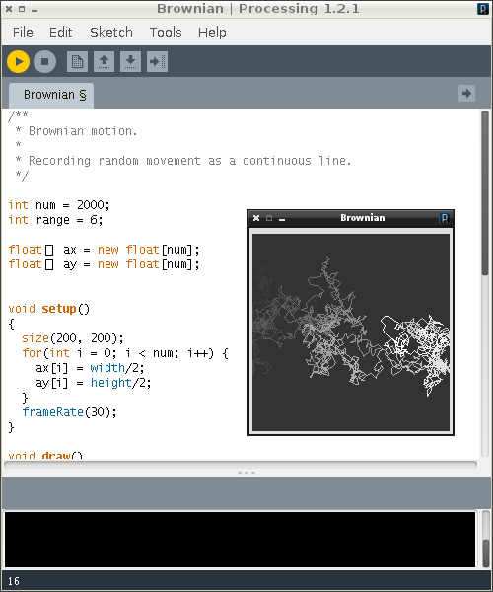
Processing (processing.org)
Processing is an open source programming built for electronic arts, new media art, and visual design with the purpose of teaching the fundamentals of computer programming in a visual context.
The project was initiated by the Aesthetics and Computation Group at the MIT Media Lab.
The language builds on the Java language, but uses a simplified syntax and graphics programming model.

Slide 15
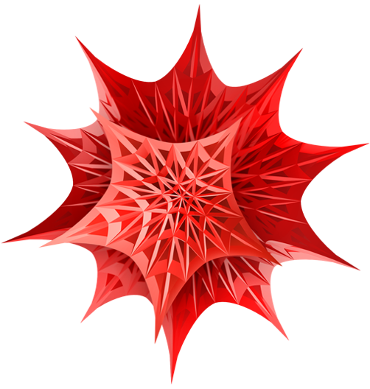
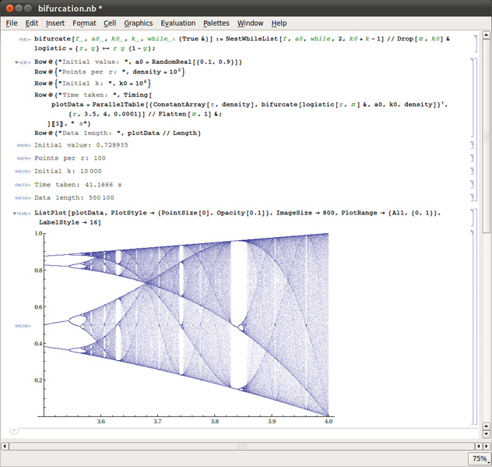
Mathematica
Mathematica is a computational software program used in many scientific, engineering, mathematical and computing fields, based on symbolic mathematics.
It has special tools for 2D and 3D image processing and morphological image processing including image recognition

Slide 16
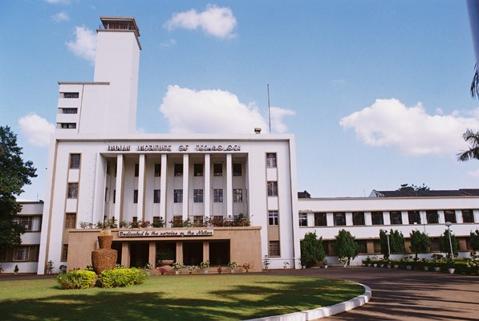
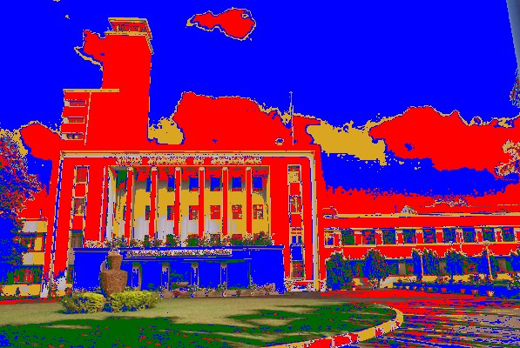
Phase 3 Fauvism
Output
Input

Slide 17
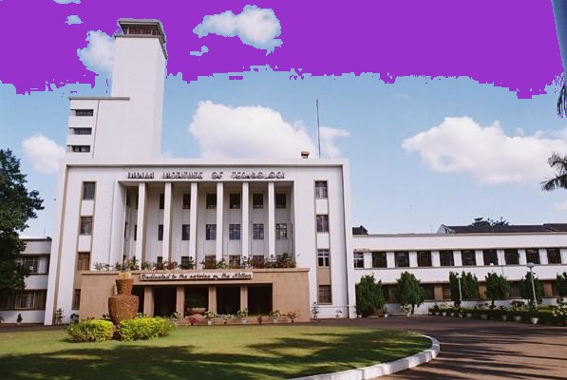
Fauvism – Overview of the algorithm
We select a random pixel from the image and scan the whole image for the pixels with RGB values close to the RGB values of the selected pixel.
A colour is selected from a pre-determined palette and all these pixels are given this colour.
This process is repeated several times.

Slide 18
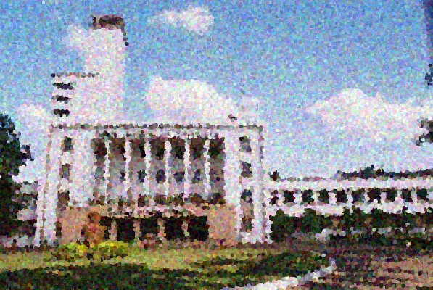
Phase 3 Pointillism
Input
Output

Slide 19
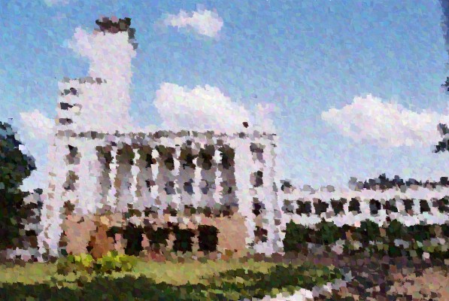
Phase 3 Pointillism
Input
Output

Slide 20
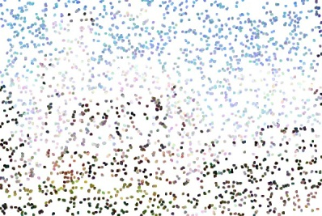
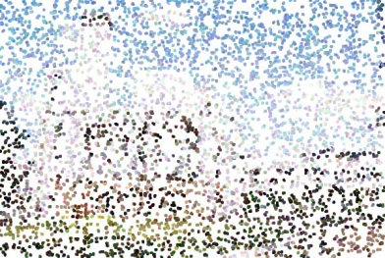
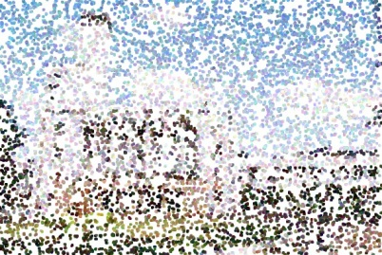
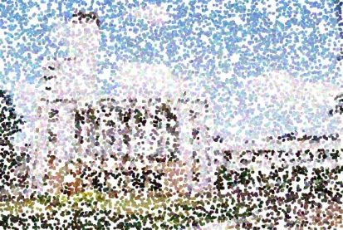
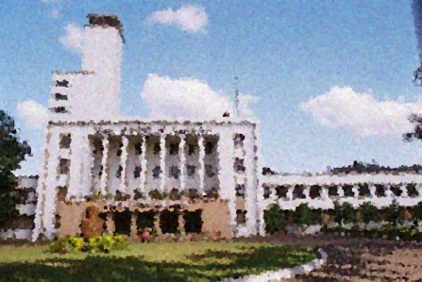
Pointillism – Overview of the algorithm
A pixel is selected at random from the image
In all the pixels at a certain pre-fixed distance from the selected pixel a circle is drawn and is filled with a RGB value close to the initially selected pixel (+/- 20 of RGB)
This induces noise into the image and gives a feeling that the image has been made up of dots.

Slide 21
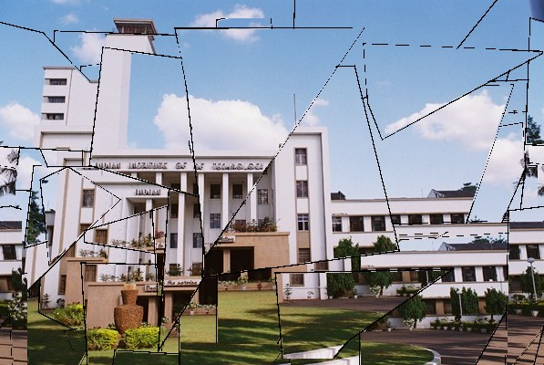
Phase 3 Cubism
Input
Output

Slide 22
Cubism – Overview of the algorithm
A duplicate of the given image is formed and a new image with a white background is created.
On the white background image a geometrical figure (quadrilateral) is drawn with a red border and filled with black colour.
Now, we go through this image (with white background) and wherever there is red pixel we put a black pixel in the original image and wherever there is a black pixel we leave the pixel with the same colour.
All the above pixels are displaced by a certain random value (dx+dy) with a pre-fixed range.
The white background image is erased and a new figure is drawn on it at a random place.
The above process is repeated several times.

Slide 23


Image that generates random Quadrilateral
Quadrilateral cut from the original image and displaced on the output image

Slide 24
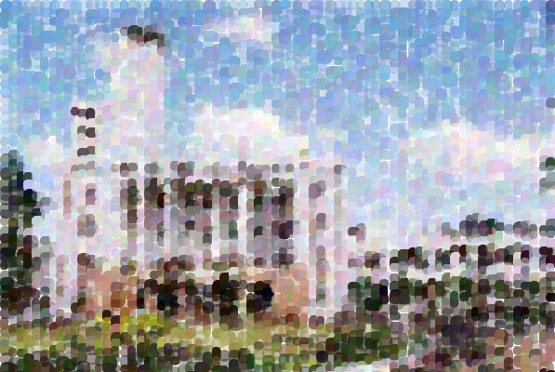
Phase 3 Divisionism
Input
Output

Slide 25

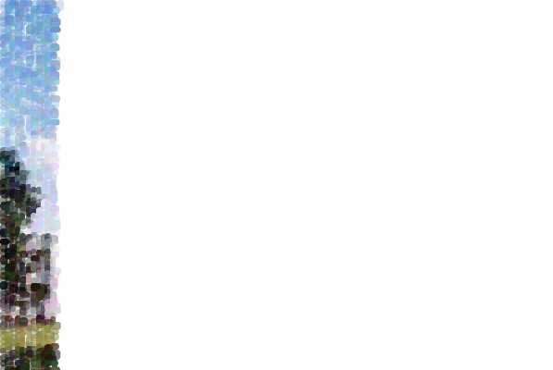
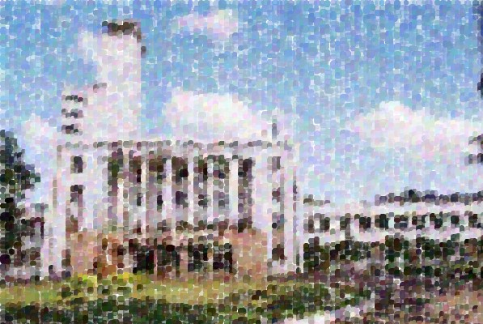
Divisionism – Overview of the algorithm
We define a quantity, s = (image_width + image_height)/100.
We traverse the image by stepping through s pixels and draw rectangles of random sizes in the ranges (s, 2*s) and (0.5*s, s) and with a curvature at their corners.
They are filled with a colour close to the pixel’s colour (+/- 20 RGB) where the rectangle starts.
In each row these rectangles are displaced by a random value in a fixed range in horizontal and vertical direction.
This is done till the bottom of the image is reached.

Slide 26
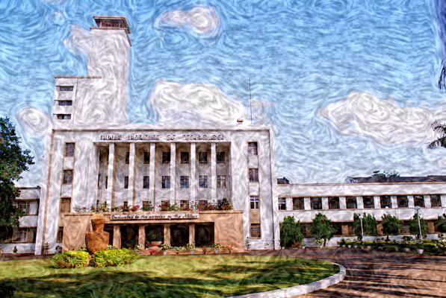
Phase 3 Post-Impressionism(Van Gogh)
Input
Output

Slide 27
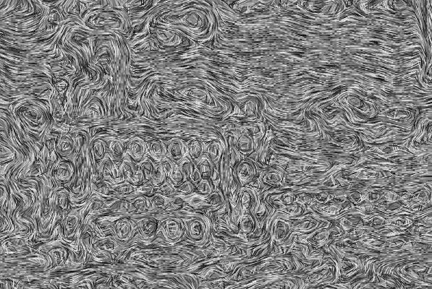
Van Gogh – Overview of the algorithm
Run a GradientOrientationFilter on a smaller version of the image to estimate the local image gradient, and use that information to create a collection of randomly shaded lines.
Use a gentle tone-mapping on the original image to equalise the brightness a bit, and then combine the ton-mapped image with the brush strokes.

Slide 28
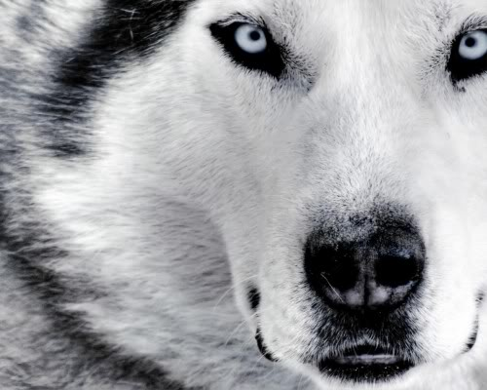
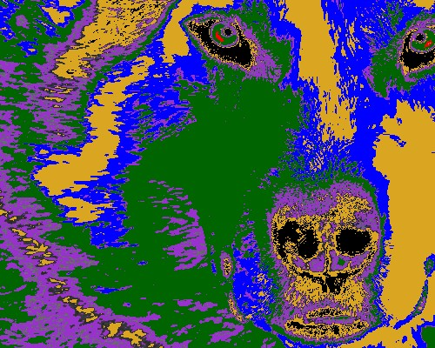
Other inputs and outputs Fauvism

Slide 29
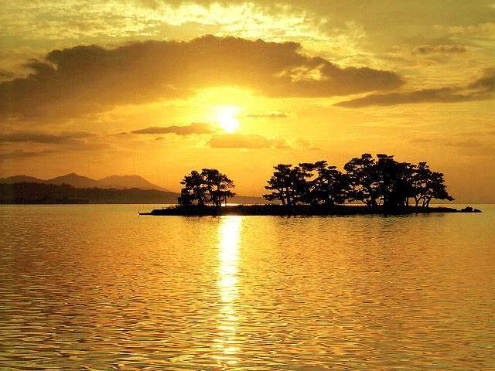
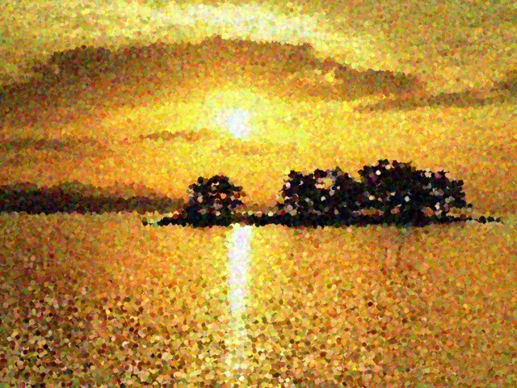
Other inputs and outputs Pointillism

Slide 30
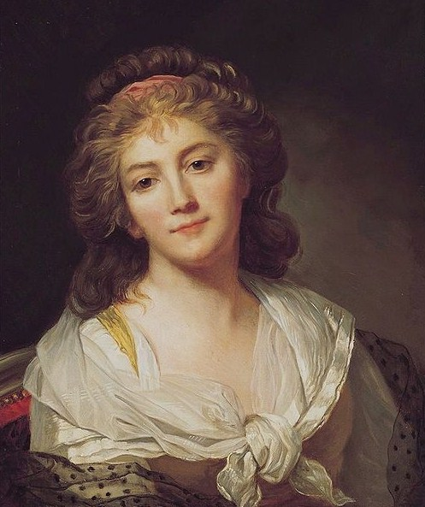
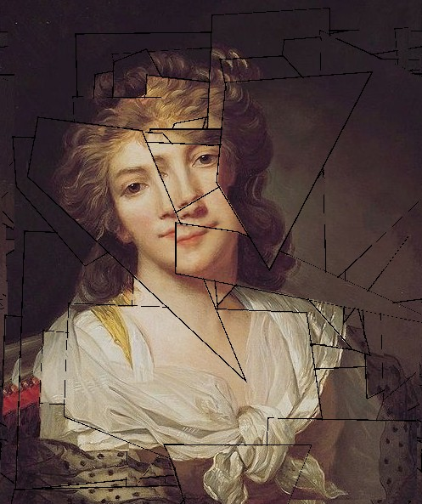
Other inputs and outputs Cubism

Slide 31
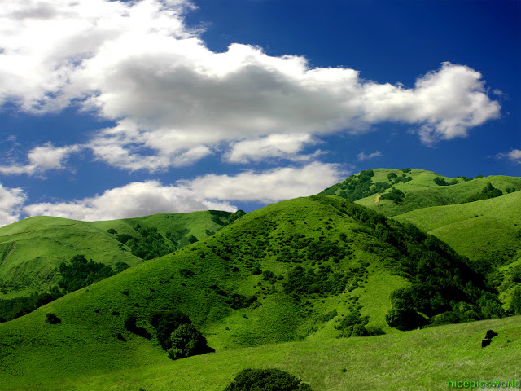
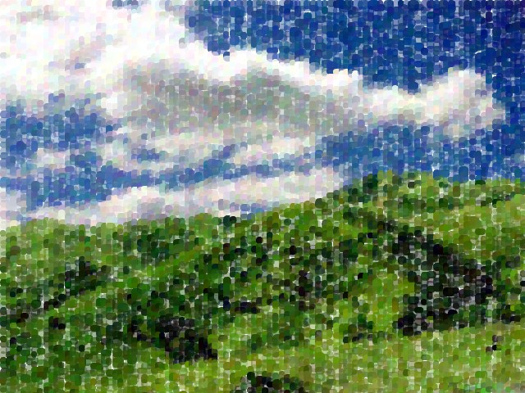
Other inputs and outputs Divisionism

Slide 32
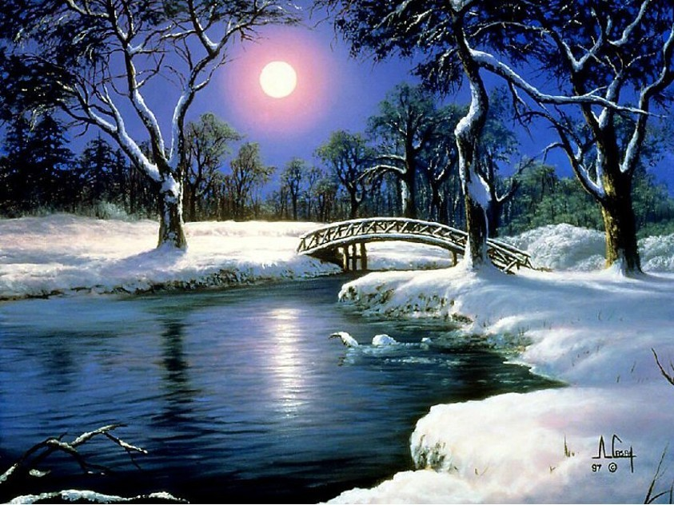
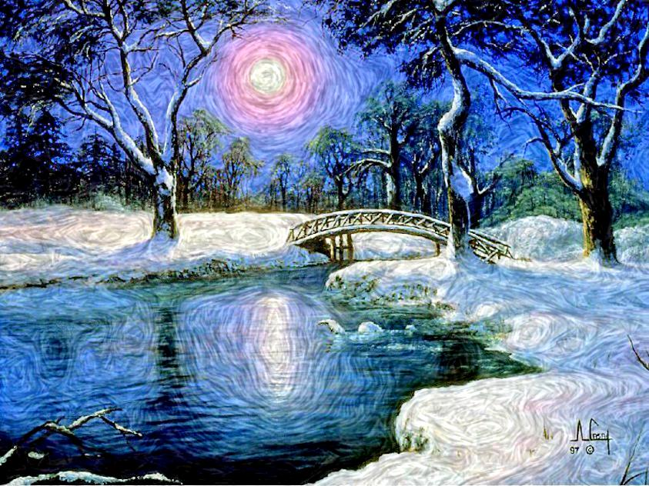
Other inputs and outputs Post-Impressionism

